Slide 2
Software Engineering Tools:
Diagnosing API issues an monitoring API performance

Slide 3

Computer Science Graduate from Brunel University
Working in the Ecommerce domain with team Pixar (Product & Sizing platform)
Previously completed an internship at AXA Investment Managers

Slide 4
Why are these tools useful?

Slide 5
Here are a few!
Identify API failures that might have been missed by automated feedback loops?
See exactly what data is being sent between whom?
Manually check that your API’s endpoints have the expected behaviour.

Slide 6

HTTP Requests

Slide 7
Types of HTTP Requests
GET- The ‘getting’ request type, used to request data from an API. (normally returns this data in the response body)
POST- The ‘sending’ request type, used to send data to an endpoint of a webservice for consumption. The data type you are sending is defined in the request header and the data itself in the request body.
DELETE- The ‘disposal’ request type, used to delete data from an endpoint or service.

Slide 8
Common Types of HTTP Responses
2xx successful - The request was received, understood and fully accepted by the server:
200 ok – Generic success status code indicating completed request.
202 Accepted- The request has been accepted by the server, hasn’t been fully fulfilled.
3xx redirect - The request was received and understood, but further action is needed to be taken by the client to complete the request.
301 moved permanently – Redirect all requests to the given URL(in body)
300 multiple choices – Indicates multiple options for the requested resource that the client wants to receive i.e. video quality settings for streaming etc.
4xx client errors - The request sent by the client cannot be processed by the server due to bad format.
400 bad request– The message cannot be processed due to a malformed request syntax, size or invalid content type.
403 forbidden– The request has a valid shape, but the server refuses to action the request due to lack of permissions for a resource, could be missing valid credentials or an invalid SSL certificate.
5xx server errors - The server the seeks client communication with is unable to process the request.
500 internal server error– Generic response for unfulfillable requests from the client.
503 service unavailable– The server is currently unavailable to fulfil the request due to maintenance or overload.

Slide 9
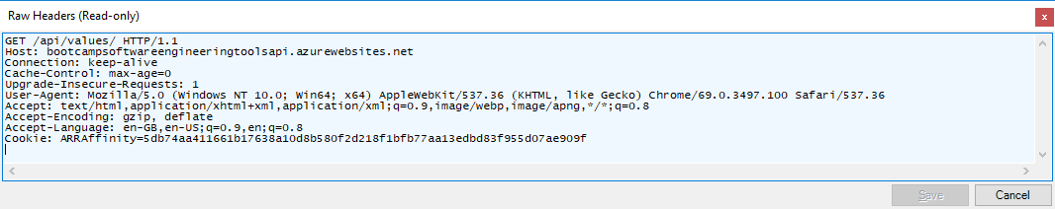
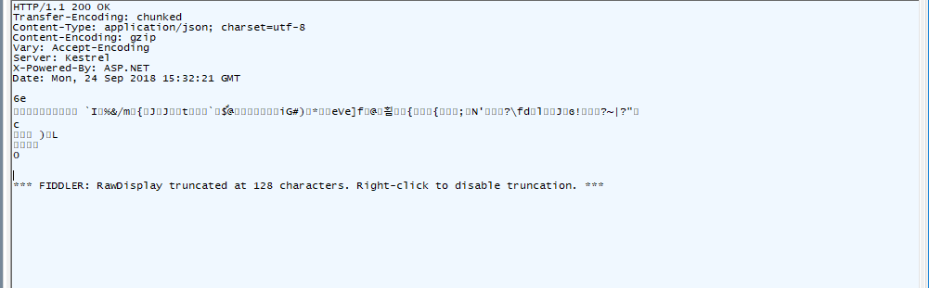
Standard GET Request Example

Slide 10
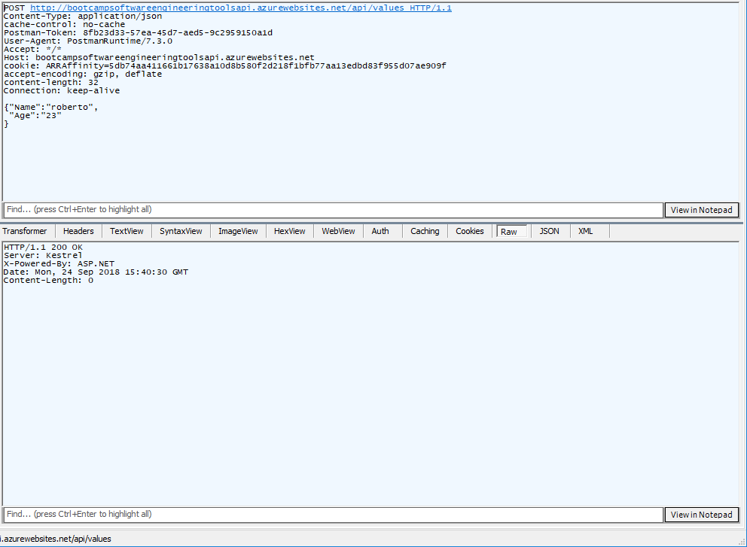
Standard POST Request Example

Slide 11
Packet Sniffers
Programs which intercept web requests and responses being sent a received on a device.
These allow you to see HTTP requests to data sources that are used to populate web pages.
Charles proxy, Fiddler, Wireshark etc.

Slide 12
Demo Time

Slide 13

Mocking API Calls

Slide 14
Request Composers
Programs which can be used to compose and send HTTP requests of different types to web services.
These allow you send to trigger responses from web API endpoints.
Postman, Fiddler, etc.

Slide 15
Demo Time

Slide 16

Performance Monitoring

Slide 17
Why do we want to monitor performance?

Slide 18
Performance Monitors
Monitor consistent behaviour and speeds in requests and responses.
Alerts can be set with different threshold values.
Can be used in combination with performance load tests to prove the resilience of a system during periods of peak load.
Speed is essential to the business!

Slide 19
Demo Time

Slide 20
Summary
There are many tools that can be used to troubleshoot and monitor our APIs.
Some are manual and can be triggered by you
Some are automated and can be used to “watch” our services in the background.
Logging can be generic using default instrumentation tools, or specific and event based using traces.

Slide 21

Demo Time

